Slide 1

Domain: MATLAB
Technology: COMMUNICATION
Clustering based on Whale Optimization Algorithm for IoT over wireless nodes

Slide 2
Index
Abstract
Introduction
Literature review
Existing Method
Disadvantages
Proposed method
Advantages
Applications
Hardware and Software Requirements
Results
Conclusion
References

Slide 3
Abstract
Wireless Sensor Network (WSN) consists of sensor nodes, collecting data from each sensor node is a challenging task, various types of clustering techniques are present for an efficient clustering. So, we are implementing a new Clustering Routing Algorithm Based on Whale Optimization Algorithm (WOA) which is so better at clustering of sensor nodes without a considerable energy overhead. Rather clustering through depending on the energy of nodes, WOA decides of whether a node will participate or not in the election of a Cluster Head (CH). Thereby, decreasing energy dissipation at a very considerable value.
Keywords – Whale Optimization Algorithm (WOA) , Wireless Sensor Nodes (WSN), Clustering, Routing.

Slide 4
Introduction:
Wireless Sensor Network (WSN) is a network of sensors that are connected to each other through wirelessly. Each sensor is considered as a node, which collects data from the environment and packets the aggregated bits and sends it to the Base Station (BS). So, the node has to use its energy heavily for all these processes. Every time a node collects its data and it should be transferred to the Base Station (BS). For transferring packets of data to the BS, the nodes have to aggregate the data bits that are collected into packets. Each time the nodes aggregating the data bits and sending to the BS by itself consumes more energy, so, the nodes a clustering method was proposed for making those all processes by a single node which is CH of that particular cluster. Through this way, all nodes need not to use their energy to collect data, process it, aggregating it and sending to the BS every time, a particular node will be elected as a CH for a cluster and it will collect the data, process it, makes the data bits into packets and sends it to the BS at a regular intervals making other nodes energy consumption low when and increasing their lifetime for a considerable time. There exists many clustering techniques, one of them are, WOA, it clusters better than any of the currently existing techniques.

Slide 5
Literature review:
S. NO | Journal Type with year | Authors | Title | Outcomes
1 | IEEE Trans. Consum. Electron. 66 (2020) 223. | P. Chanak and I. Banerjee | “Congestion Free Routing Mechanism for IoT-Enabled Wireless Sensor Networks for Smart Healthcare Applications ” | Studied about routing mechanism for making congestion free in IoT
2 | IEEE Access 9 (2021) 65660 | M. N. M. Bhutta and M. Ahmad | “Secure Identification, Traceability and Real-Time Tracking of Agricultural Food Supply During Transportation Using Internet of Things” | Studied about identification, traceable and tracking of things using IoT
3 | IEEE Internet Things J. 6 (2018) 3024. | J. B. Valencia, L. C. Londono, D. M. Viloria, and M. R. Garcia: | “Lightweight Dynamic Auto-Reconfigurable Protocol in an IoT-Enabled WSN for Wide-Area Remote Monitoring” | Studied about LDAP in with WSN for WARM
4 | IEEE Trans. Smart Grid 10(2019)4323 | S. A. Alavi, K. Mehran, Y. Hao, A. Rahimian, H. Mirsaeedi, and V. Vahidinasab | “A Distributed Event-Triggered Control Strategy for DC Microgrids Based on Publish-Subscribe Model Over Industrial Wireless Sensor Networks” | A networker is employed for observing network traffic was studied
5 | IEEE Trans. Wireless Commun. 19 (2020) 696. | Q. Li, N. Zhang, M. Cheffena, and X. Shen | “Wireless communication Basics” | Contains every thing related to wireless communications

Slide 6
Existing method:
Low Energy Adaptive Clustering Hierarchy (LEACH) Protocol is a founding or one of the earliest techniques for clustering of sensor nodes. LEACH protocol uses the energy values of the nodes and their random numbers which is a value between 0 and 1. Later, a threshold value will be calculated based on the probabilities of a node becoming a CH and their random numbers, then, those nodes which have energies higher than the threshold will be selected as CHs and each CH display it through a message of becoming a CH. Remaining nodes will join the nearest CH and forms clusters. Every time the nodes sends its data to the CH in their time slots, CH will transmits it as a packets to the BS. After, the CH reaching below the threshold value it will become a node again and the node which has next highest energy than the threshold value will becomes CH.

Slide 7
Disadvantages in Existing methods:
If any CH will be dead then, the packets from that particular cluster will never reaches the BS resulting in loss of data of that cluster.
There exists an unbalanced energy consumption when the rounds goes on.
There is no optimal limit for the number of nodes in a cluster.

Slide 8
Proposed method:
There exists a number of techniques for clustering of nodes in a WSN, but none of them are good at clustering, they results in extending the lifetime of the nodes of the network but, not on the clustering. We are implementing a new technique known as Whale Optimization Algorithm (WOA). WOA is an algorithm that works on mainly the fitness function for reducing and balancing energy consumption and network coverage. The WOA starts with the initial set up phase, which generates a set of random solutions for a problem. The solutions are improved over time during the process, whenever the solutions will be better. Unlike, the remaining algorithms WOA takes into account the neighbors and their respective distances from the base station. The remaining energy Erem is also taken for the election of cluster heads (CH). The CH will be calculated based on the distances from the BS and their remaining energies. CHs are changed whenever their criteria falls below. Fitness function introduction in this algorithm is a whole new concept when it comes to checking the or selecting the CHs. Fitness function will be calculated at every stage to make the fitness even more robust. After, all of the CHs are selected and the CHs will allocate a Time Division Multiple Access (TDMA) for sending the data to CH which will pass the aggregated packets to the BS.

Slide 9
Advantages of Proposed method:
1. Cluster Heads are calculated based on the fitness function.
2. Calculation of fitness function at every stage of the process makes the CH selection even more robust.
3. Clustering is done through fitness function which results in a better clustering than the previous existing methods.

Slide 10
Applications:
1. IOT environment
2. Satellite communication
3. Weather and temperature forecasting

Slide 11
Hardware and Software Requirements:
Hardware & Software Requirements:
Software: Matlab R2018a.
Hardware:
Operating Systems:
• Windows 10
• Windows 7 Service Pack 1
• Windows Server 2019
• Windows Server 2016
Processors:
Minimum: Any Intel or AMD x86-64 processor
Recommended: Any Intel or AMD x86-64 processor with four logical cores and AVX2 instruction set support
Disk:
Minimum: 2.9 GB of HDD space for MATLAB only, 5-8 GB for a typical installation
Recommended: An SSD is recommended a full installation of all Math Works products may take up to 29 GB of disk space
RAM:
Minimum: 4 GB
Recommended: 8 GB

Slide 12
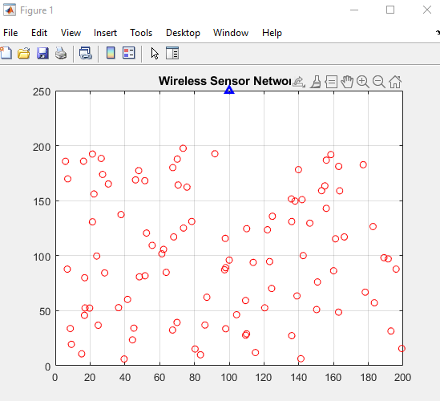
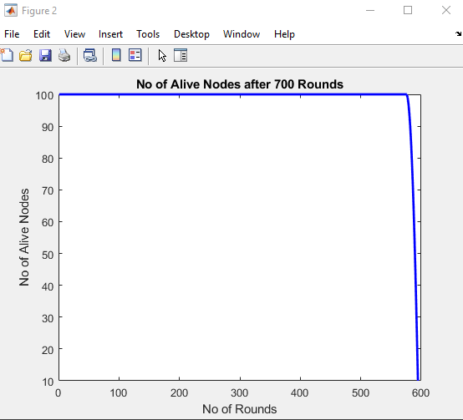
Results:

Slide 13
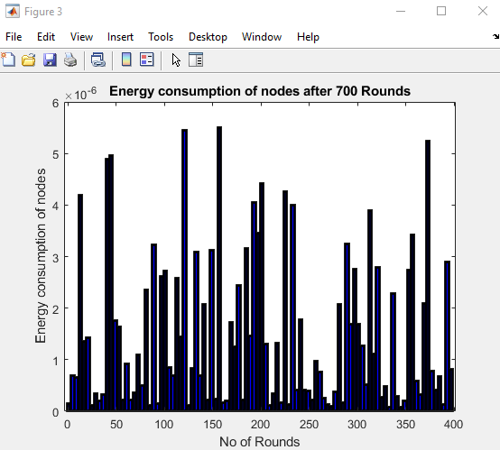
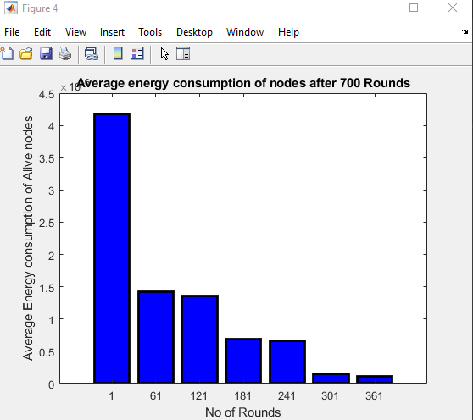
Results:

Slide 14
Concluion:
Using IoT technology which is implemented through wireless nodes is a new trend in the world. Limited energy is the most important challenge in these networks. Sending and receiving messages is the main reason for consuming energy. Hence, designing an efficient method for routing and managing messages could have a significant impact on the network’s lifespan. In the proposed method, a concentrated clustering method, which has been implemented by WOA, is designed to tackle the problem. Inter-cluster interactions have been managed by means of multi-hop approach which has energy saving considerations. Saving more energy, load balancing and CH coverage at different points of the network are the main objectives in fitness function control messages are replaced by status messages in order to reduce messaging overhead. The performance of the algorithm has been analyzed in terms of energy consumption. Results suggest that NUWC managed to improve the level of stability and lifespan. Moreover, it can balance energy consumption and throughput of the network. In future works, it is intended to develop the proposed method for IoT over energy harvesting wireless nodes

Slide 15
References:
[1] P. Chanak and I. Banerjee: IEEE Trans. Consum. Electron. 66 (2020) 223.
[2] M. N. M. Bhutta and M. Ahmad: IEEE Access 9 (2021) 65660.
[3] . B. Valencia, L. C. Londono, D. M. Viloria, and M. R. Garcia: IEEE Internet Things J. 6 (2018) 3024.
[4]. S. A. Alavi, K. Mehran, Y. Hao, A. Rahimian, H. Mirsaeedi, and V. Vahidinasab: IEEE Trans. Smart Grid
10(2019)4323.
[5] Q. Li, N. Zhang, M. Cheffena, and X. Shen: IEEE Trans. Wireless Commun. 19 (2020) 696.

